Slide 1

Algoritma Pemrograman Dasar :
Javascript
3
Day 4

Slide 2
1
Conditioning
Outline Class
2
Looping

Slide 3
Conditional Statements
In computer programming, there may arise situations where you have to run a block of code among more than one alternatives. Very often when you write code, you want to perform different actions for different decisions.
You can use conditional statements in your code to do this.
In JavaScript we have the following conditional statements:
If
Else
Else If
Ternary Operator
Switch Case

Slide 4

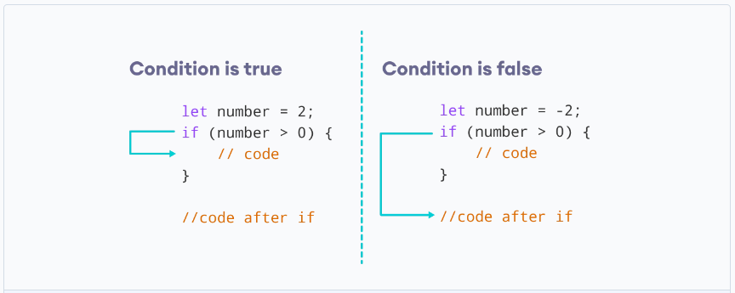
The if Statement
Syntax :

Slide 5
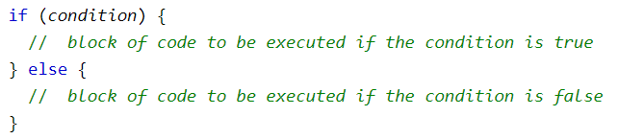
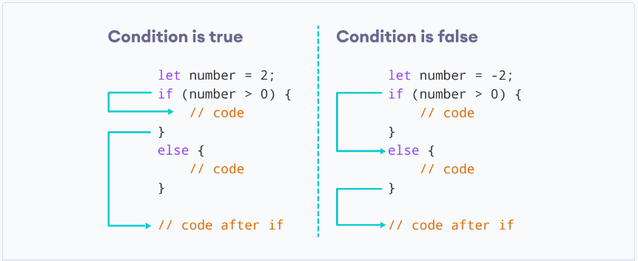
The else Statement
Syntax :

Slide 6
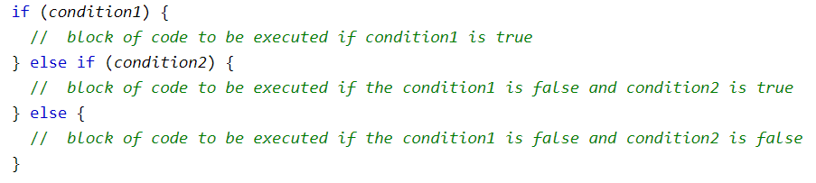
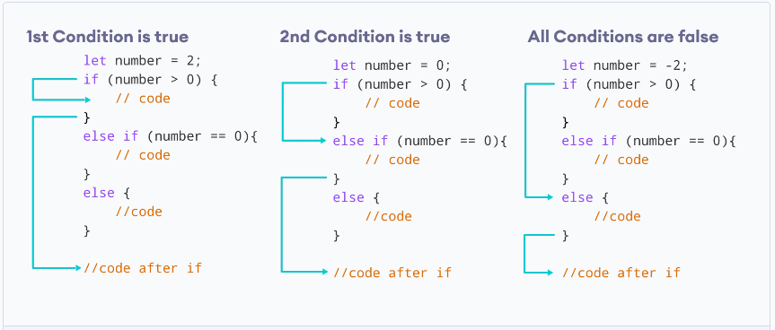
The else if Statement
Syntax :

Slide 7
Conditional (Ternary) Operator
Syntax :
condition ? expression1 : expression2

Slide 8
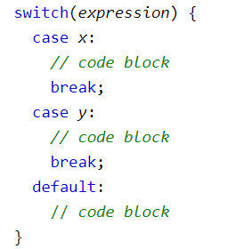
Switch Case

Slide 9

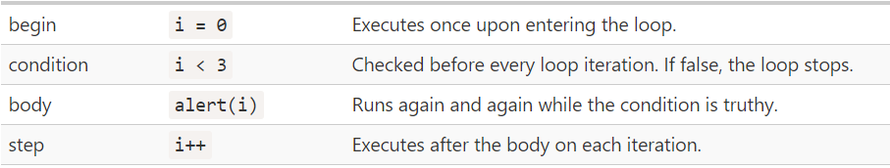
Looping
Loops can execute a block of code a number of times.
For
Note

Slide 10
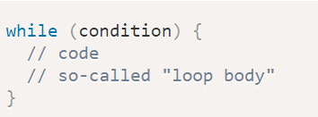
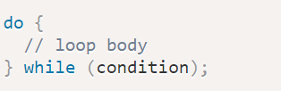
While
A while loop evaluates the condition inside the parenthesis ().
If the condition evaluates to true, the code inside the while loop is executed
Do While
The body of the loop is executed at first. Then the condition is evaluated.
If the condition evaluates to true, the body of the loop inside the do statement is executed again

Slide 11
Thank you

